Slide 1
Air Quality Index Prediction
Anshul Singh, Sujit Soren and Sehej Jain

Slide 2
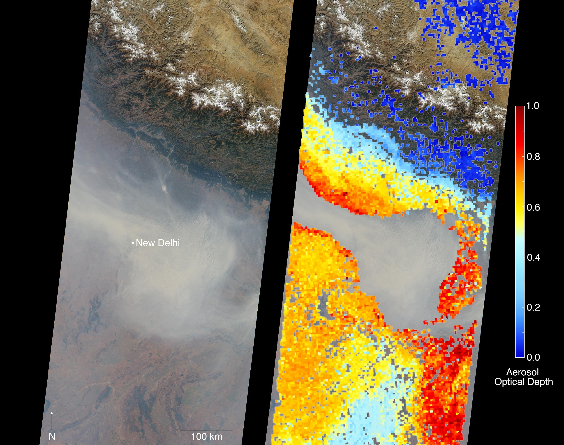
The Problem Statement
Air pollution has become an important environmental issue in the recent decades. Forecasts of air quality play an important role in warning people and controlling air pollution.
Using Machine Learning it is possible to train a model which can take in air quality data for certain areas of India and for both Regression and Classification problems, that is, by calculating Air Quality Index in the Regression part and then classifying raw new data into AQI classes.
Notes:
Referring to the figure on the right.
The left portion represents a satellite image showing the solution, and the right portion shows thermal analysis obstructed by air pollution. The severity of this problem can be seen here.

Slide 3
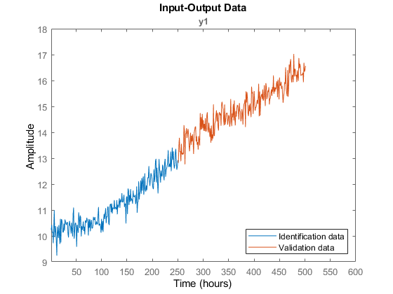
Trend analysis and Modeling for the future
As instructed by you, we looked into trying to take the Air Pollution data for the past 10 years and modelling and predicting for the next 10 years.
The problem we encountered in this approach was that this cannot be done by conventional Machine Learning Algorithms since this becomes a time-series prediction problem.
We would need to apply ARIMA and SARIMAX techniques here.
An Example of Time Series Forecasting Problem

Slide 4
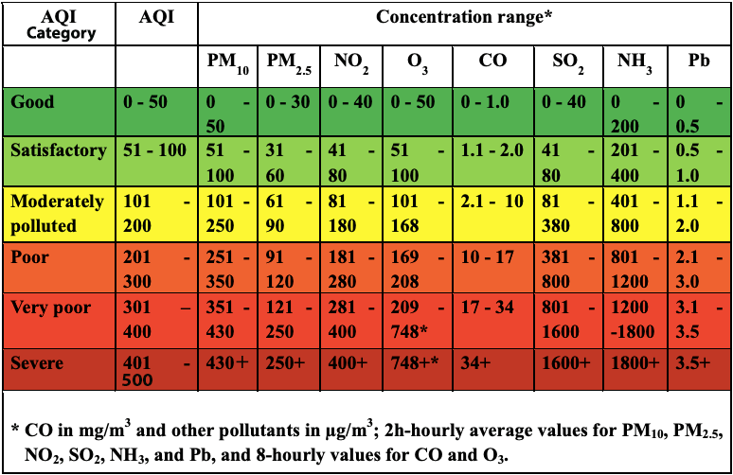
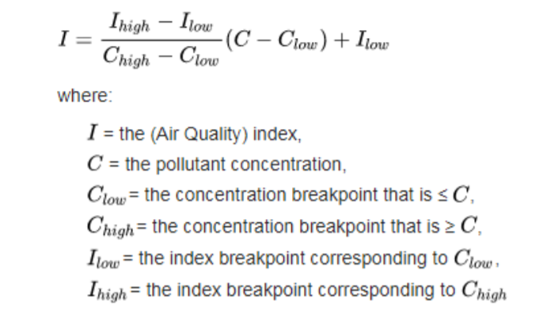
Objective
The first objective is to compute the AQI, air quality index, and then split the data into training and test sets based on the below features.
Independent Features: SOi, NOi, RSPMi, SPMi (the calculated pollution indices)
Regression Target Feature: AQI (calculated Air Quality Index)
Classification Target Feature: AQI Classes
Notes:
Individual Air Quality Index is calculated using the formula on the right.
Using this calculation, we can train a regression model which does AQI calculation for new data in the deployment part.

Slide 5
DataSet Analysis
The data is combined (across the years and states) and largely clean version of the Historical Daily Ambient Air Quality Data released by the Ministry of Environment and Forests and Central Pollution Control Board of India under the National Data Sharing and Accessibility Policy (NDSAP) year 1990-2015
Notes:
Since our focus of the problem is on classification, Linear Regression will be used in an intermediary stage to generate a helper model for training our classification models.
This way this is a hybrid problems comprising of two stages.

Slide 6
Challenges Faced and and Our Approach towards it
The Govt of India’s Ministry of Environment and Forests’ dataset that we have used here lacks a lot of values in various parameters. The parameter with the highest amount of null values was SPM. We had faced a difficult boundary to cross due to the sheer number null values, and for this other regression techniques were applied.
While data preparation, SO2, NO2 and RSPM column features were taken as independent variables and SPM was taken as the dependent variable for solving the issue of null data. We used Random Forest Regression for this which gave excellent results.

Slide 7
Classification Results with 8 Classifiers
Model | accuracy
logistic_regression_1 | 45.44%
logistic_regression_2 | 46.26%
decision_tree_1 | 71.51%
decision_tree_2 | 58.17%
random_forest_1 | 99.65%
random_forest_2 | 99.70%
svc_1 | 50.15%
svc_2 | 97.93%
KNN_1 | 99.22%
KNN_2 | 98.94%
naive_bayes_1 | 34.74%
naive_bayes_2 | 28.96%
catboost_1 | 99.43%
catboost_2 | 99.35%
Passiveaggressiveclassifier_1 | 77.27%
Passiveaggressiveclassifier_2 | 53.05%
Notes:
For classification, we selected 8 classifier models to work with and explored what can be done with the data that we have. The table shows the accuracy results of these classifiers. As comparison, the models marked 1 are the ones with the original approach of directly using concentration of pollutants as variables for Quality and the models marked 2 are the ones with the approach that we have considered.

Slide 8
Conclusion
In this project we have done an analysis on various possible methods of applying Machine Learning methods in the domain of Air Quality and pollution.One of the main challenges we faced was the absence of consistent data. The data had a lot of null values for which we had to compensate. We also explored a new methodology to work on Air Quality, which was having AQI as an intermediary to classify air quality.

Slide 9
Contributions
All 3 of us have worked as a great and hardworking team and have contributed equally in the making of this project. We worked on the Indian Air Quality Index and the workload through the project was divided among us as follows:
Anshul Singh (2018301): Cat Boost, Multinomial Naive Bayes, Passive Aggressive
Sehej Jain(2018225): SVC, Logistic Regression, KNN
Sujit Soren (2018247): Decision Tree, Random Forest
The add on feature of Air Quality Index was calculated through consistent efforts by all three of us.
All the necessary research and information for making the report were shared among us all in order to make this entire project successful.

